Slide 1
Data Mining-based Approach for Robust Bankruptcy Prediction
Avishek Dasgupta, Kavyasri Jadala, Vineeth Pydi

Slide 2
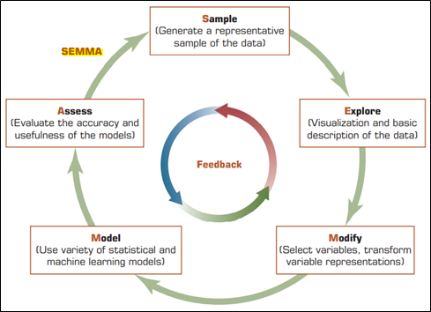
Process
Sample
Sampling
Explore
Data visualization
Replacement
Transform Variables
Modify
Model
Neural networks
Gradient boost
Logistic models
Tree based models
Model Assessment
Assess

Slide 3
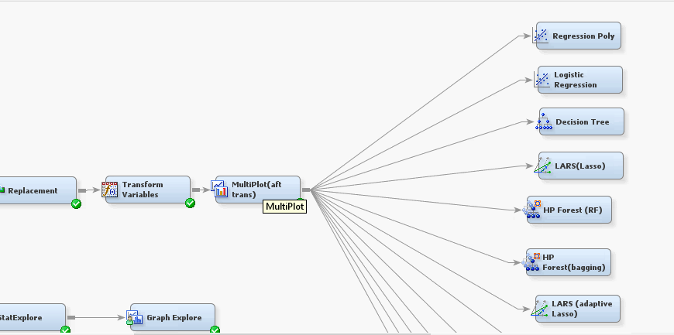
INITIAL APPROACHES
Polynomial regression, Logistic regression, Decision tree, Lasso, HP Forest, Bagging, Adaptive lasso
Key Takeaways
c
Initially we tried models with default parameters
Validation ROC: ~85- 90
Optimal Models
Neural Network
Gradient boosting

Slide 4
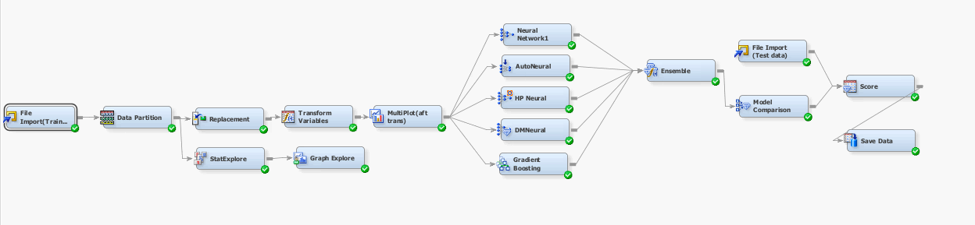
FINAL MODEL

Slide 5


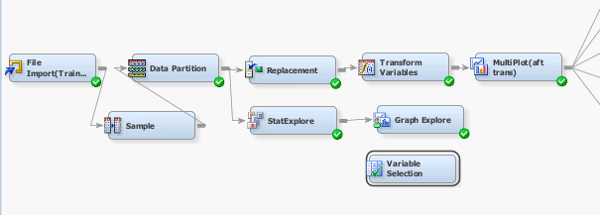
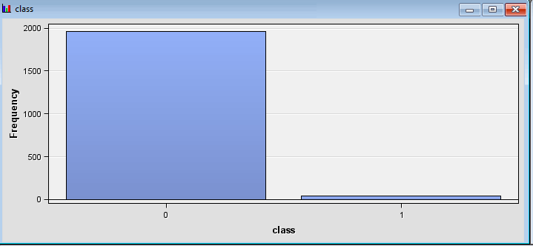
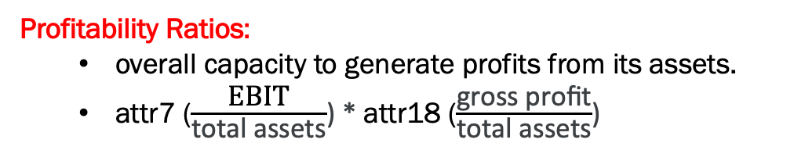
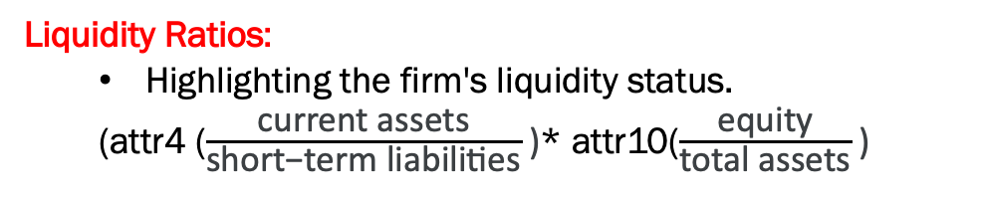
DATA PREPROCESSING
Replacement of missing values (3 Std Dev from mean)
Outliers transformation
Set to 75:25
Stratified sample- 80% (Representing unbalanced class)
2 Interactive terms added
Liquidity Ratios:
Highlighting the firm's liquidity status.
(attr4 ($\frac{\text{current} \text{assets}}{\text{short}\text{−}\text{term} \text{liabilities}}$)* attr10($\frac{\text{equity}}{\text{total} \text{assets}}$)
Profitability Ratios:
overall capacity to generate profits from its assets.
attr7 ($\frac{\text{EBIT}}{\text{total} \text{assets}}$) * attr18 ($\frac{\text{gross} \text{profit}}{\text{total} \text{assets}}$)

Slide 6
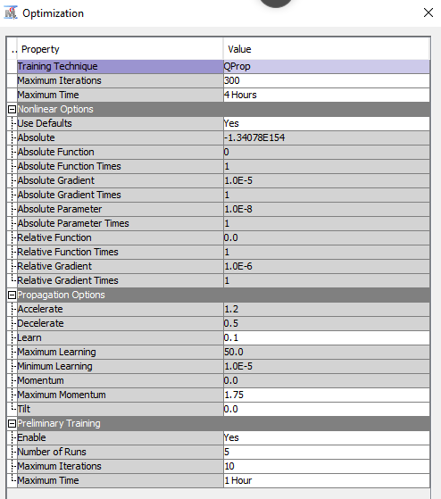
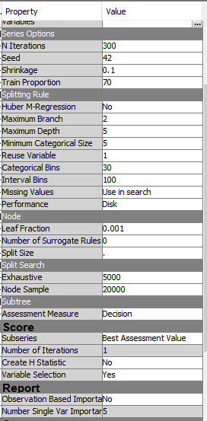
MODEL NODES
Neural Network
Gradient Boosting
c
NEURAL NETWORK:
QuickProp for faster convergence
N Iterations: 300
No. of Hidden units = 3
Learning rate: 0.1
GRADIENT BOOSTING:
N Iterations: 300 iterations
Train Proportion: 70%
Maximum Depth: 5

Slide 7
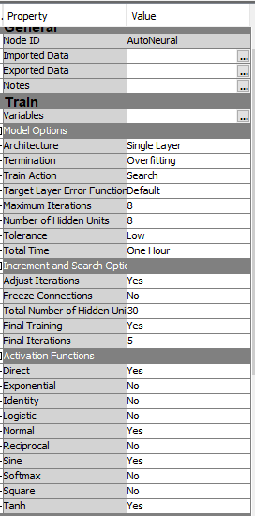
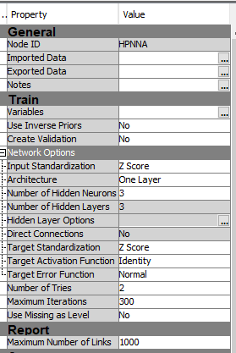
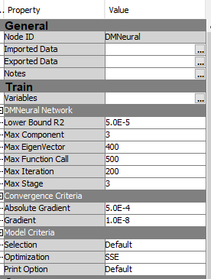
MODEL NODES
Auto Neural
HP Neural
DM Neural
Model Advantage
AUTO NEURAL:
Architecture: Single Layer
Termination: Overfitting
Hidden Units: 8
HP NEURAL:
Hidden Layer Level Customization : 3
DM NEURAL:
Optimization: SSE

Slide 8
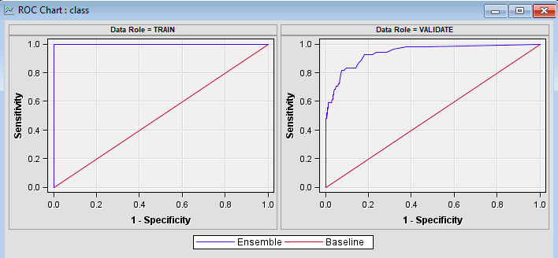
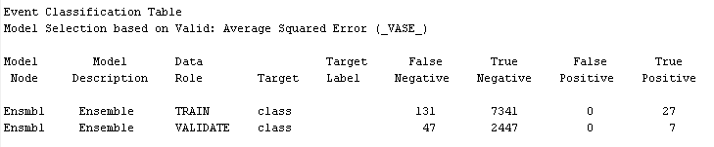
OPTIMAL MODEL EVALUATION: ENSEMBLE APPROACH
Ensemble with Neural Network, Autoneural, HP Neural, DM Neural, Gradient Boosting
Predecessor Node | Ensmbl
Target Variable | class
Valid: Number of Wrong Classifications | 47
Valid: Roc Index | 0.942

Slide 9
CONCLUSION & LESSONS LEARNT
Model-based Lessons:
Hyperparameter tuning leads to improved ML model performance (ROC)
Preprocessing Optimization is crucial and should be considered in our study
Future scope:
For imbalanced data, we could consider SMOTE
Interactive terms should be liaised to achieve high throughputs.
Business Insights:
Bankruptcy is dependent on these features:
Attr 56 - (sales - cost of products sold) / sales
Attr 34 - operating expenses / total liabilities
Attr 46 - (current assets - inventory) / short-term liabilities
Attr 44 - (receivables * 365) / sales
Attr 5 -(cash + short-term securities + receivables - short-term liabilities) / (operating expenses - depreciation)] * 365
These financial metrics are key because they reflect a company's profitability, cash flow, expense management, liquidity, and ability to pay debts—factors critical for assessing the risk of bankruptcy

Slide 10
Thank You

